Slide 1
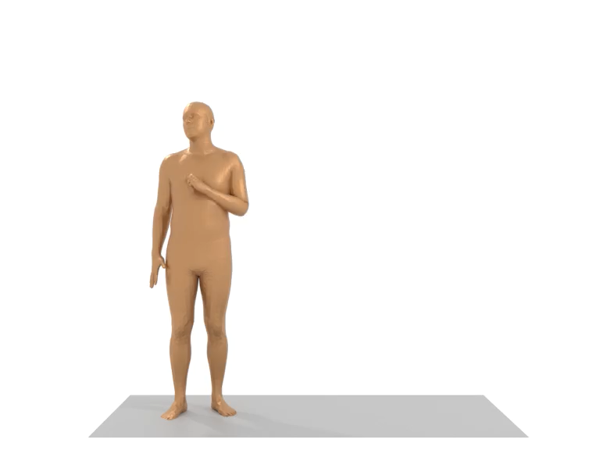
SYNTHETIC HUMAN MOTION GENERATION For AR
Name: Tejas Ramakrishnan Mentor: Myungjae Jeon Team: Samsung Research Augmented Reality Lab
12th July 2023

Slide 2
NEED FOR human motion data?
AR user experience is heavily dependent on accurate human motion prediction
Delays lead to misalignment between the virtual content and the physical world, leading to a sense of time latency and dizziness for users.
Hence there is a need for accurate human motion prediction for a good virtual experience.
To develop accurate algorithms for 6DOF motion prediction, human motion datasets are needed.
Such data helps determine future position and viewpoint within an environment, allowing for proactive adjustment of virtual content based on anticipated perspective.

Slide 3
WHY SYNTHETIC GENERATION?
Capturing human motion data physically can be expensive and time-consuming.
Synthetic data generation as an alternative is a feasible and cost-effective alternative.
Synthetic data generation techniques enable the creation of large-scale and realistic human motion datasets.
This project addresses need of synthetic human motion data for reducing AR latency.
However, it is a challenging task, due to the diversity of possible motion and the difficulty of accurately describing it.

Slide 4

Project goals
To generate framework for synthetic human motion generation for reducing latency in AR applications through advanced motion prediction algorithms.
Targets:
Pure Human Motion
With scene w/o interaction
Including interaction with surrounding

Slide 5

LITERATURE REVIEW

Slide 6
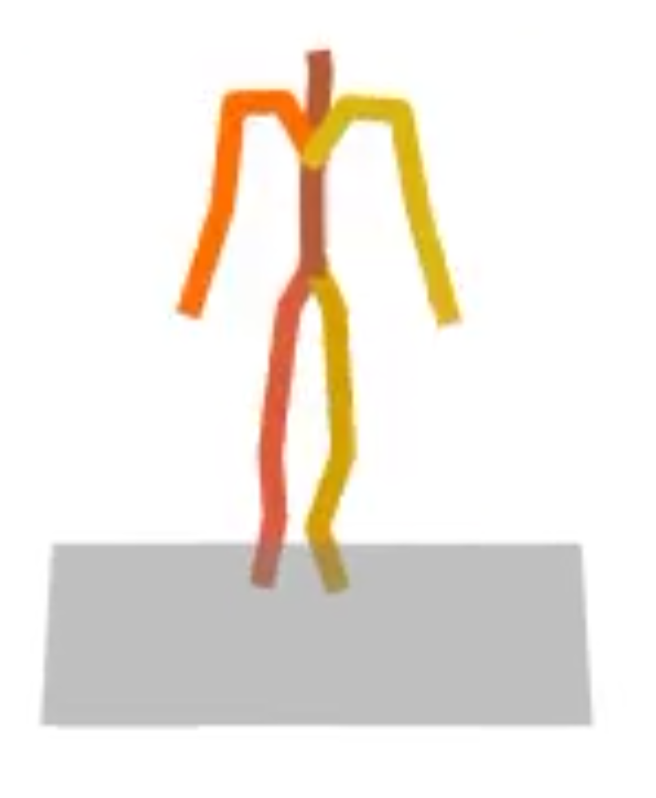
Without scene generation
Human motion is generally modelled as the positions of joints in space over a given time
Many of the older generative/VAE based models are either low-quality or limited in expressiveness.
Diffusion models are promising candidates for human motion due to their many-to-many nature.
They generate high quality human motion with sufficient variability but are resource heavy and hard to control.
Existing models include:
T2M(Transformer based Text to motion human motion synthesis
MDM(Diffusion Based Text to Motion)
MoDi( for purely unsupervised setting)

Slide 7
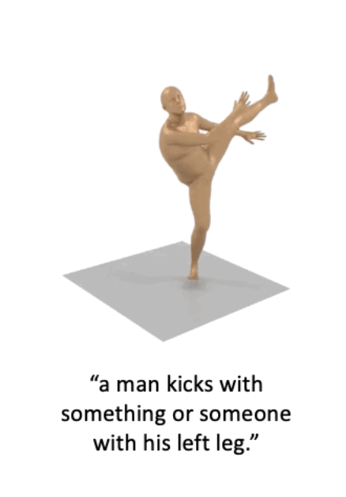
MOTION DIFFUSION MODEL(MDM)
Motion Diffusion Model (MDM) is chosen for our use case
MDM is ideal because it SOTA in generating diverse, realistic human motion.
It also produces good results for unconditioned generation
MDM produces output that can be easily converted to SMPL format, useful for possible additions of scene to human motion.
MDM requires significantly fewer GPU resources
It predicts the sample, rather than the noise, in each diffusion step. This facilitates the use of geometric losses on the locations and velocities of the motion(like FCL).

Slide 8
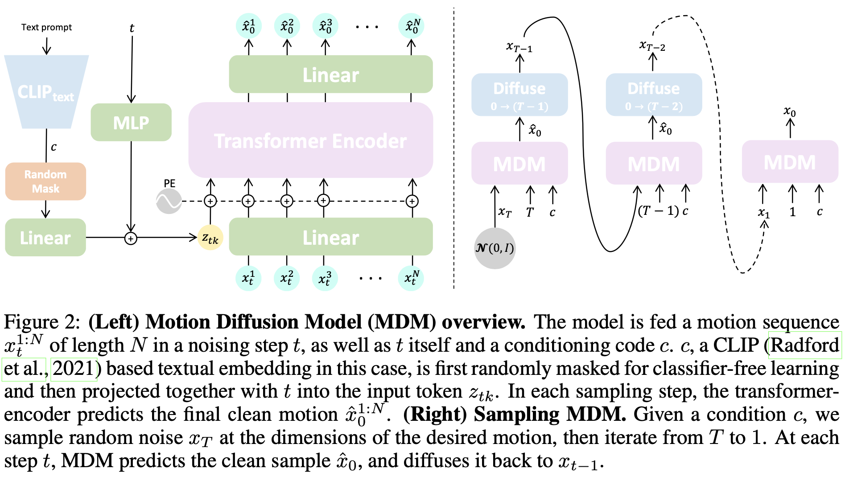
MDM ARCHItecture

Slide 9
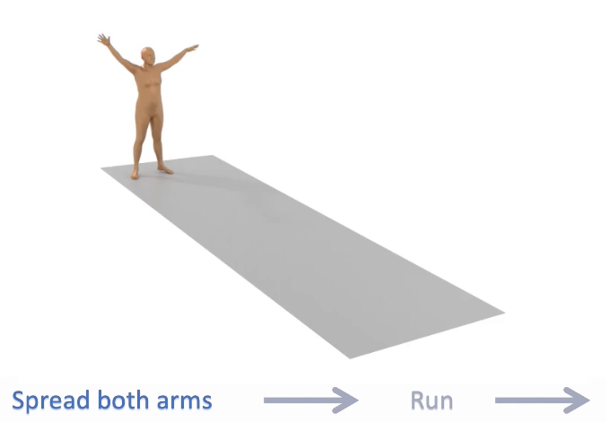
Limitations of MDM and extension
MDM generates motion that is very short(a maximum of 6 seconds, so longer motions are not produced)
PriorMDM introduces a method called DoubleTake, which enables the efficient generation of long motion sequences in a zero-shot manner using MDM as a prior.
Natural transitions can be achieved. PriorMDM is incorporated for long motion

Slide 10
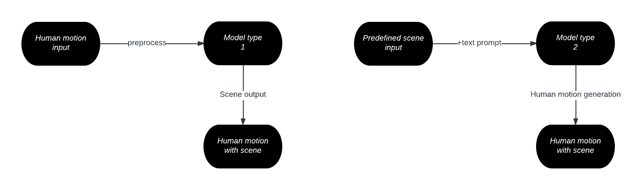
REVIEW: WITH SCENE Generation
SUMMON, MIME
Broadly classified into two classes of models
HUMANISE, SceneDiffuser

Slide 11
WITH SCENE GENERATION(CONT.)
The second class of models are largely CVAE based
cVAE models utilize an encoder-decoder structure to learn the posterior distribution and rely on the learned latent variables to sample.
Although cVAE is easy to train and sample due to its simple architecture and one-step sampling procedure, it suffers from the posterior collapse problem.
The main issue with such models was that they gave more importance to the scene
These models try to fit the generated human to the scene rather than the scene to the human, which gave unrealistic motion and usually in limited environments.
The first model type, like SUMMON, was chosen as it maintained integrity of human motion

Slide 12
Scene Synthesis from HUMan MotiON (SUMMON)
Human motion alone contains rich information about the scene they reside in and interact with.
SUMMON synthesizes feasible scenes using down-sampled SMPL-X human mesh input.
Two step framework:
ContactFormer: Model to obtain contact labels from human motion.
Based on these predictions, SUMMON then chooses interacting objects and optimizes physical plausibility losses; it further populates the scene with objects that do not interact with humans.
SUMMON also has pipeline simplicity, good results, and possibility of integration with MDM/ other T2M models

Slide 13
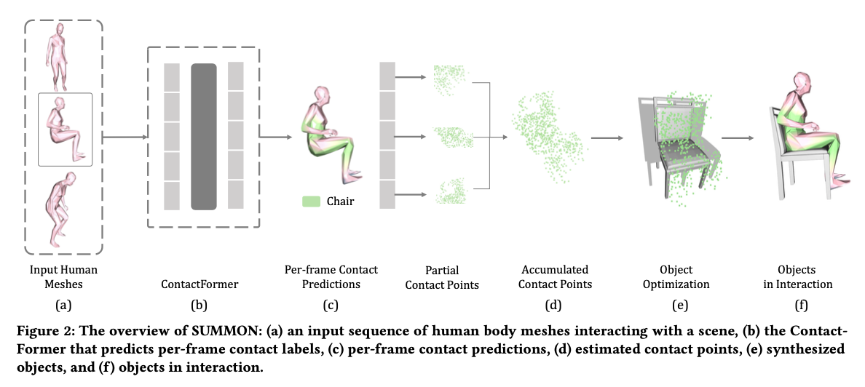
Summon Architecture

Slide 14

PROGRESS AND Deliverables

Slide 15
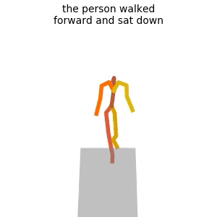
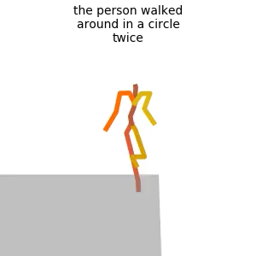
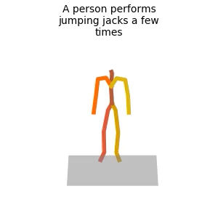
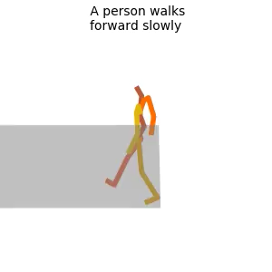
MDM+ Doubletake IMPLEMENTATION
Example outputs
Working instance of Motion diffusion model set up on GPU with conda environment
With text input/unconditioned, produces stick figure mp4 output with temporal joint positions
PyTorch based framework for generating short term human motion
Extended with DoubleTake implementation of PriorMDM for long term motion generation, with output in the same format
Long motion

Slide 16
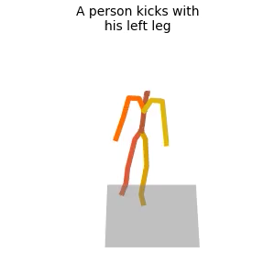
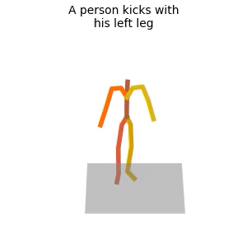
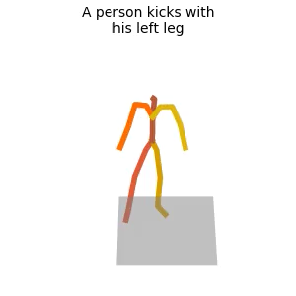
Target 1: DIVERSE DENSELY Annotated HUMAN DATASET generation
HumanML3D is one of the largescale motion datasets that has textual annotations
Each clip in HumanML3D comes with 3-4 sentence descriptions annotated on Amazon Mechanical Turk
Such descriptions may look like:
a man kicks something or someone with his left leg.#a/DET man/NOUN kick/VERBa something/PRON or/CCONJ someone/PRON with/ADP his/DET left/ADJ leg/NOUN#0.0#0.0
HumanML3D is difficult to reconstruct, as it requires processing of entire AMASS dataset from scratch
MDM models great diversity in human motion and is used to generate densely annotated human motion dataset
Subtly different motions of same input text
Notes:
Pass output of contactFormer through softmax function using –save_probability argument.
contactFormer now produces a 8 dimensional vector for each vertex of each frame, indicating the probability of each of the 8 object categories.

Slide 17
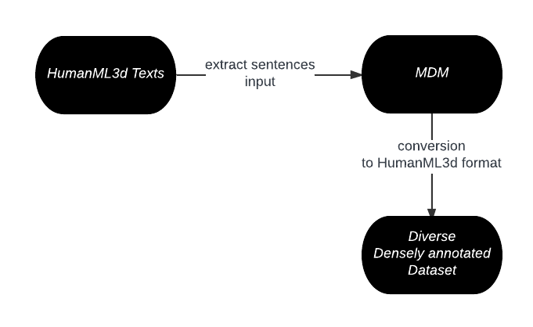
Target 1: DIVERSE DENSELY Annotated HUMAN DATASET generation
Modified object fitting pipeline
Wrote script to extract human action descriptions that can be passed to MDM
Input given to MDM to generate diverse motions
Re-linking the dense textual description to each output video gives densely annotated dataset
Created simple shell script for creating output
Easier process than generating HumanML3D itself
Notes:
Pass output of contactFormer through softmax function using –save_probability argument.
contactFormer now produces a 8 dimensional vector for each vertex of each frame, indicating the probability of each of the 8 object categories.

Slide 18
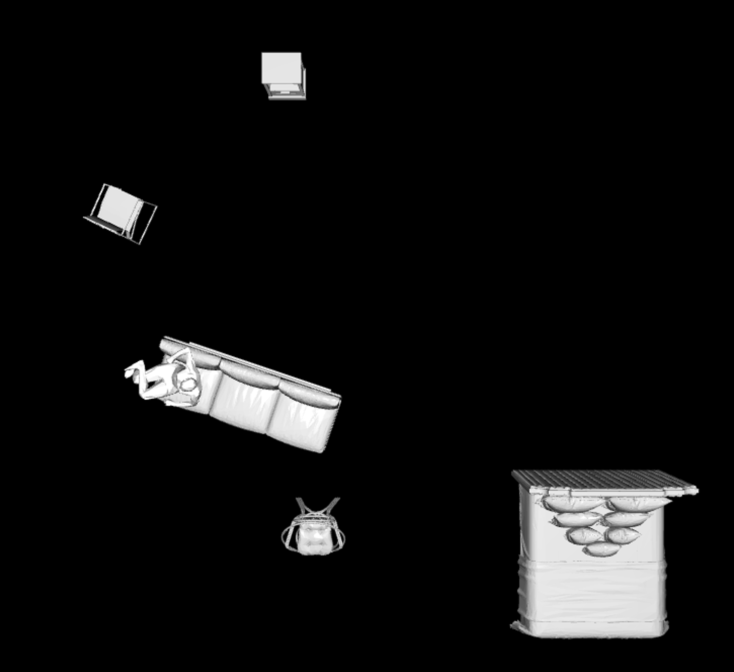
SUMMON+SMPLX implementation
Working instance of SUMMON and SMPLX set up on GPU with unified conda environment
With human motion input in normalized down-sampled form, gives scene interaction
Allows scene completion by adding objects that human does not interact with.
PyTorch based framework for generating human motion with scene.

Slide 19
Target 2: one-to-many scene generation
To generate multiple plausible scenes from single human motion input: of two types :
One that generates a ”new” scene by replacing semantically similar objects in place of earlier ones(like chair for a sofa)
One that replaces another “version” of the same object from 3D-Future dataset that applies well to the scene

Slide 20
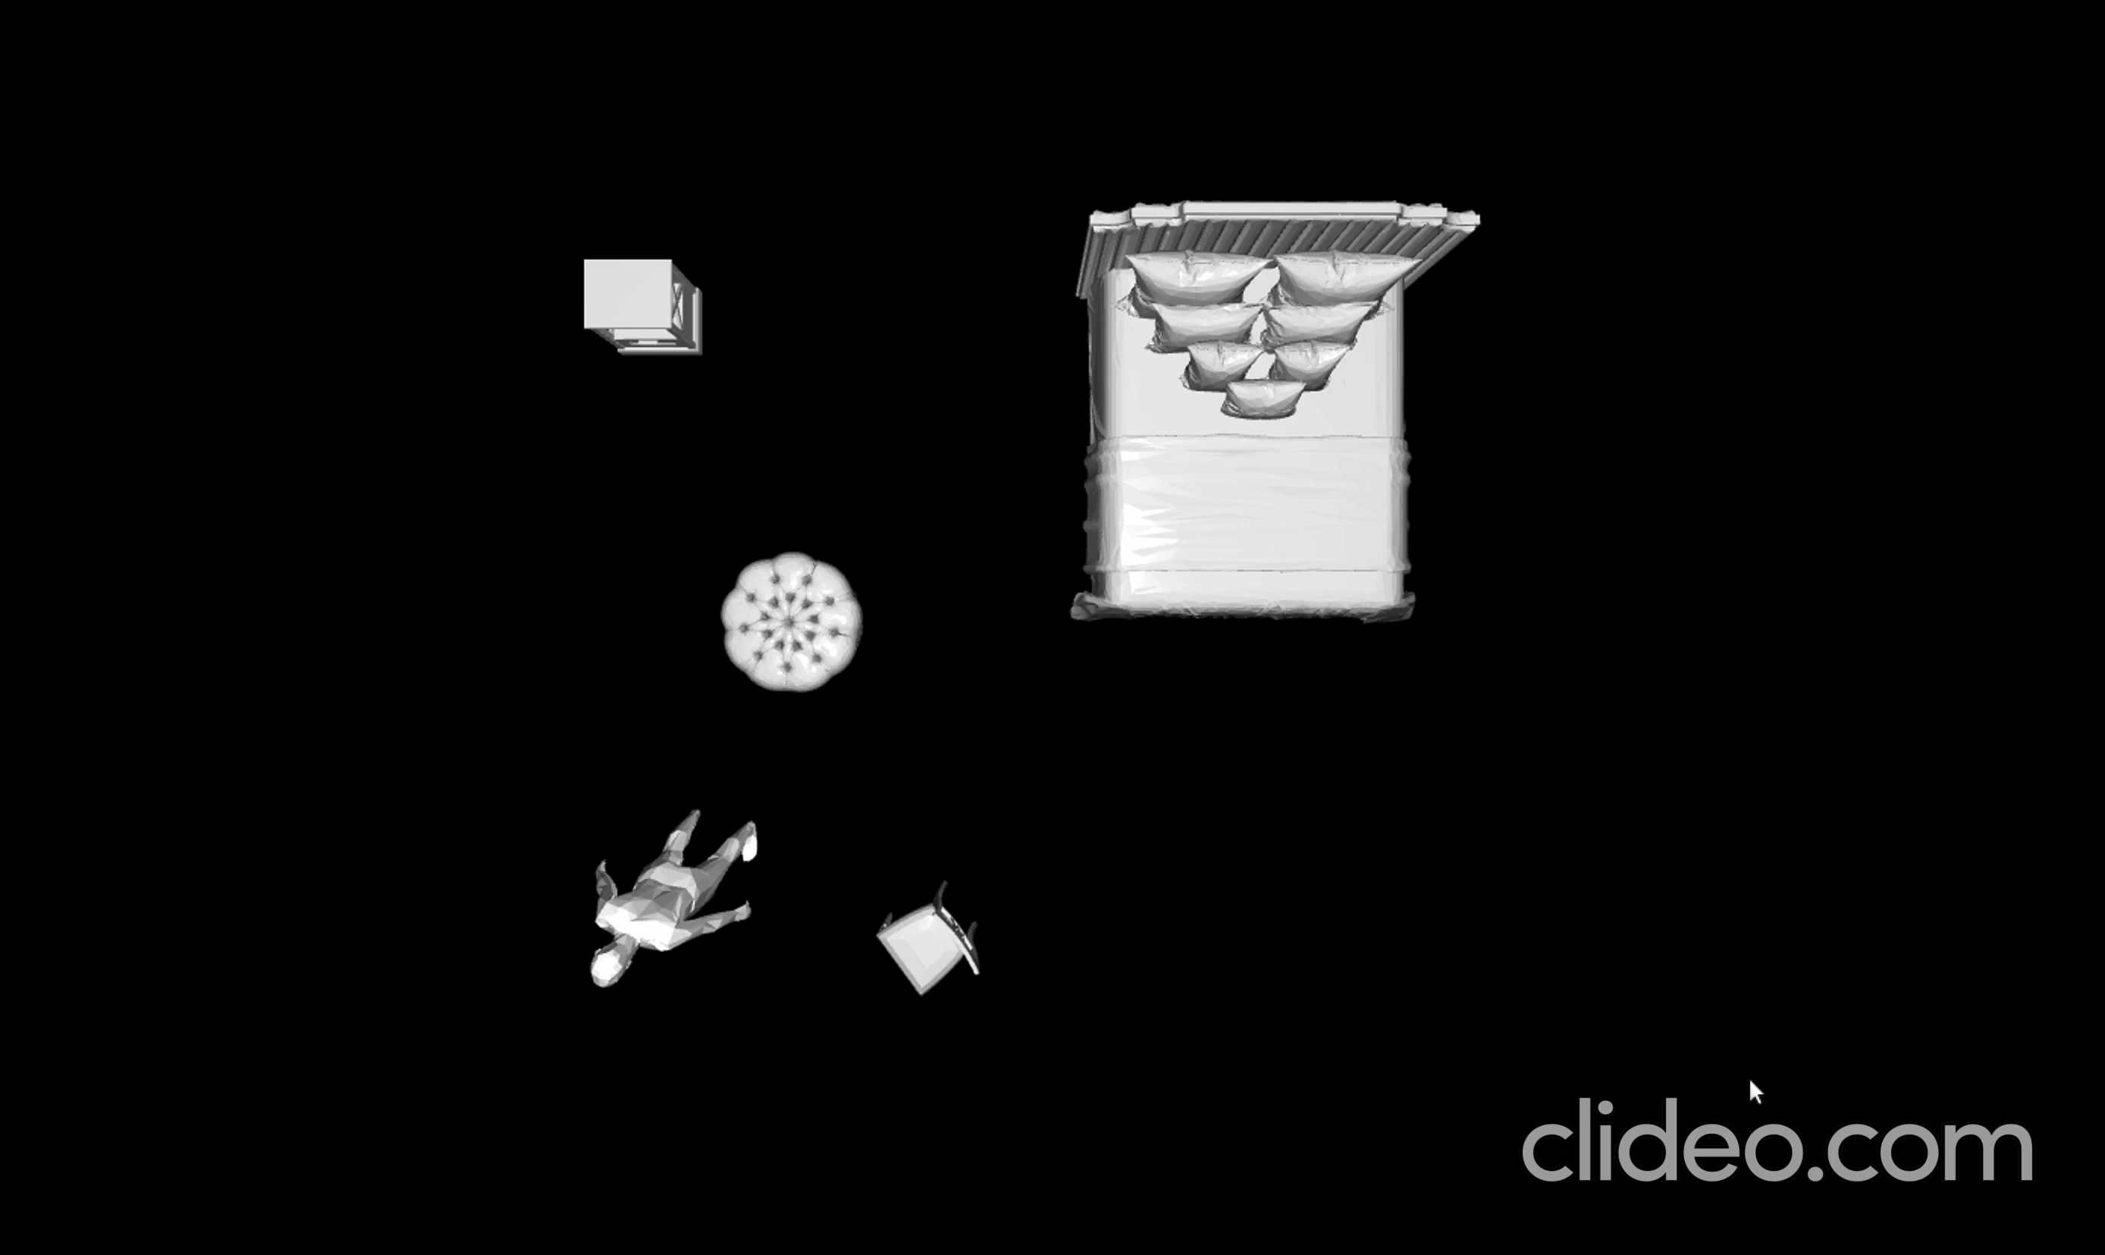
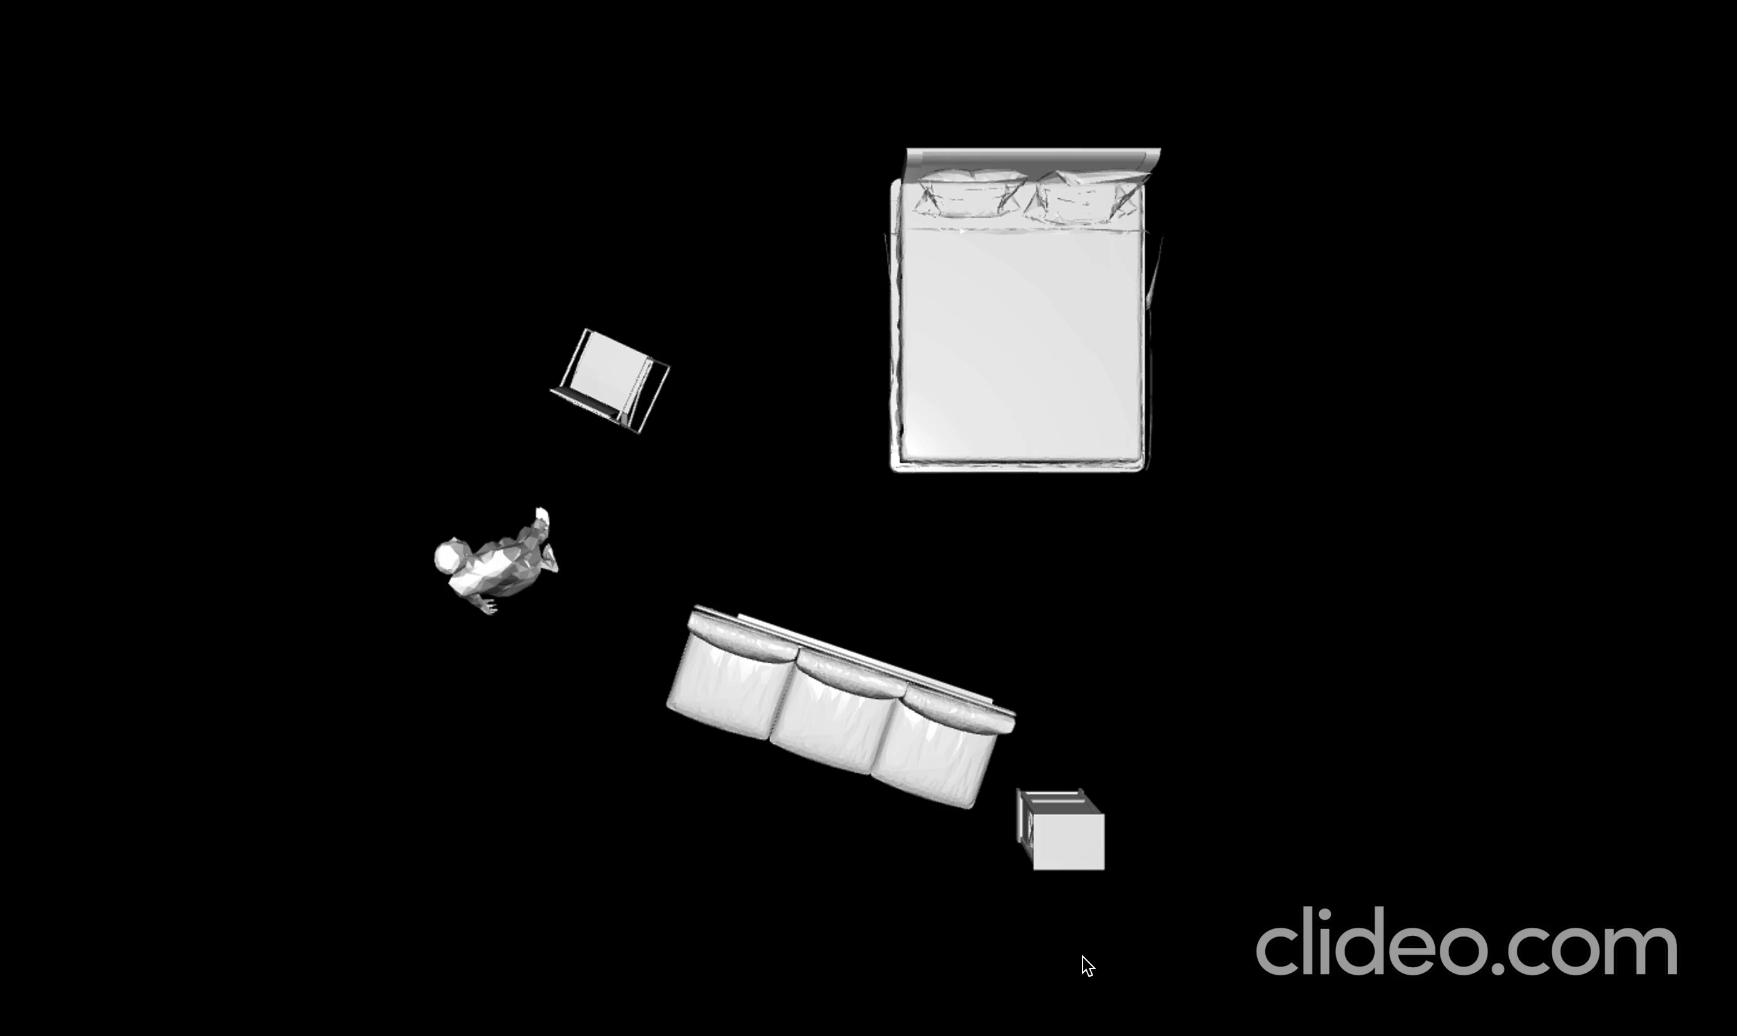
DIversE SCENE EXAMPLE: Type 1

Slide 21
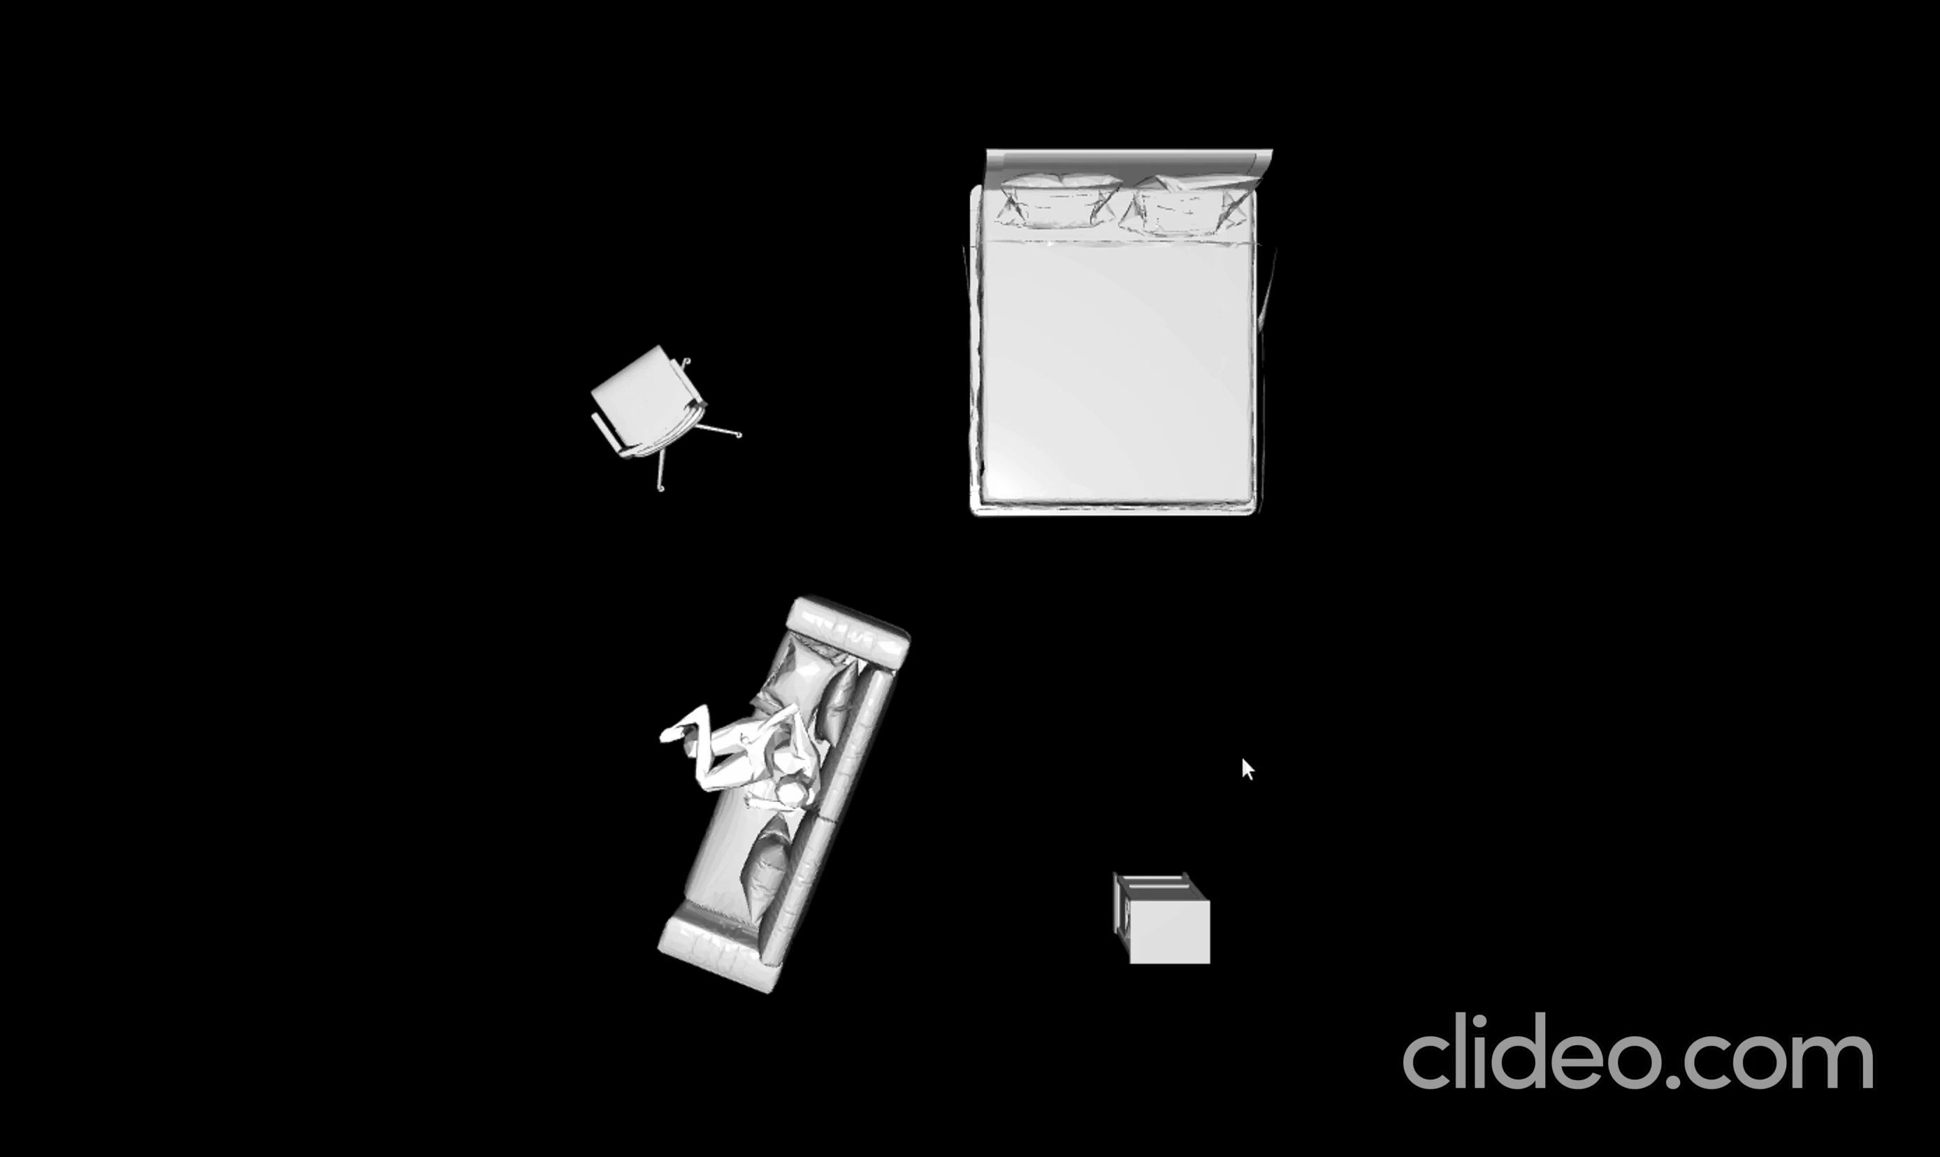
DIversE SCENE EXAMPLE: Type 2

Slide 22
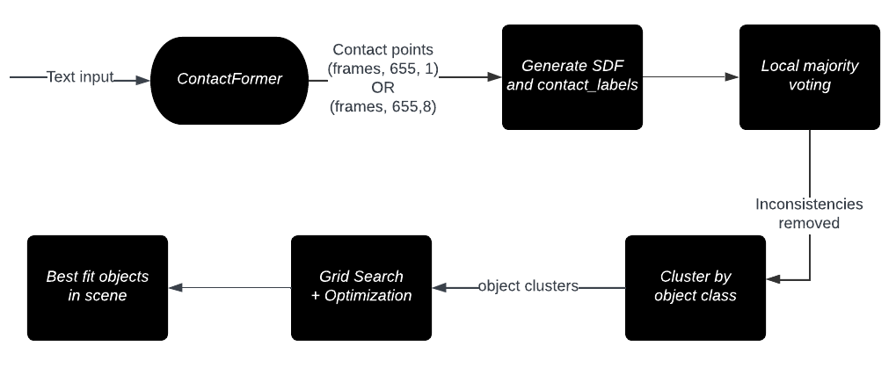
TARGET 2: EXISTING OBJECT FITTING PIPELINE
ContactFormer module gives prediction tensor indicating “most likely” semantic label (3 for chair, 2 for floor etc) of object the human is in contact with
Signed Distance field is calculated
Contact points are clustered using DBSCAN
Local Majority Voting is performed which removes small inconsistencies in clusters
Cluster points together by object class
Grid search and optimize to find best fit object
Place point cloud of best object into scene

Slide 23
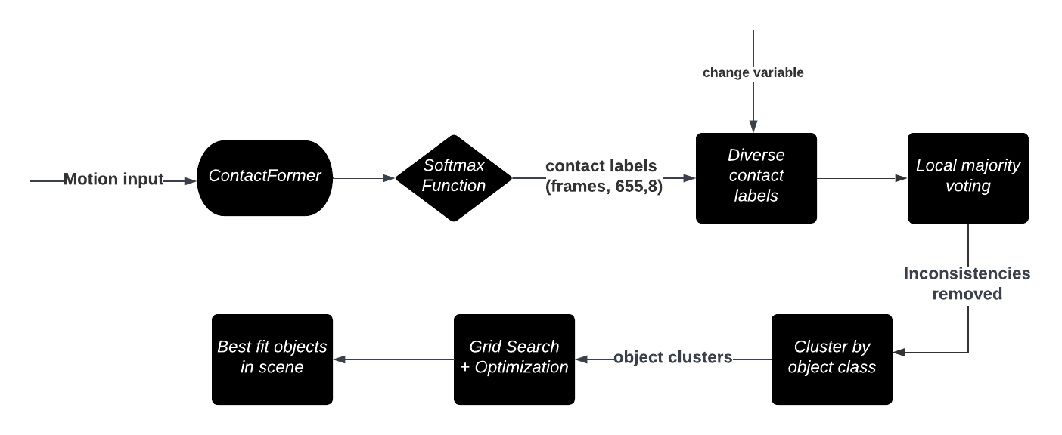
TARGET 2: MODIFICATIONS TO PIPELINE
Modified object fitting pipeline
Target: generating diverse scenes from human input
Softmax function used for probabilities of contact
Using a new variable to indicate how much “change” we want from the “most probable scene” we can generate new scenes with realistic interaction.
For vertices where contact predicted is neither void nor floor, and if the probability of the second most likely object is greater than a threshold probability “p”(hyperparameter), choose the less likely object
Code allows for introduction of subtle changes in scene(different version of same object) by choosing sub-optimal fit that is still within feasible loss range.
Notes:
Pass output of contactFormer through softmax function using –save_probability argument.
contactFormer now produces a 8 dimensional vector for each vertex of each frame, indicating the probability of each of the 8 object categories.

Slide 24
Targets 3 & 4: SYNTHETIC PIPELINE FOR MOTION SYNTHESIS
One of the limitations of existing realistic scene creation/completion algorithms is that they are dependent on input human motion, almost always in SMPL-X format
Such human input motions are expensive to capture and limited in availability.
The process of generating a Human object interaction (HOI) scene becomes dependent on human Motion Capture(MoCap) data.
To make the pipeline completely synthetic, it is necessary to pass generated human motion through scene creation/completion algorithm.
Target 3: Generation of scene w/o interaction directly from MDM output of pure human motion
Target 4: Generation of scene with interaction using MDM output of pure human motion (for example, addition of a chair when human sits down)

Slide 25
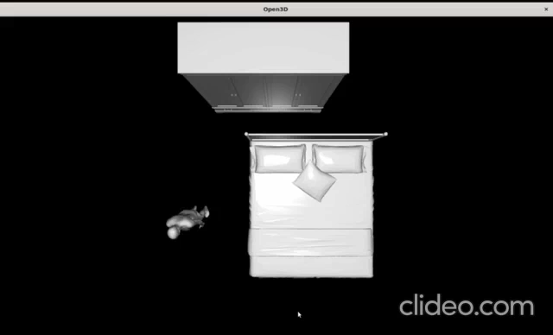
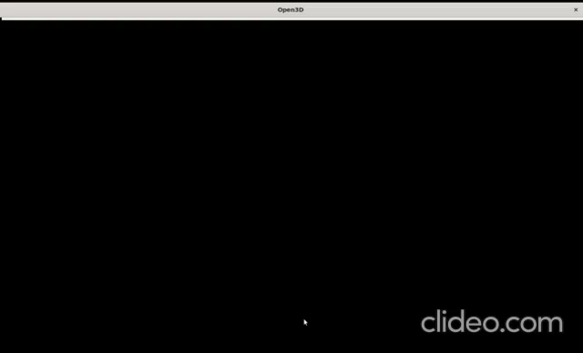
target 3: EXAMPLE VIDEOS
Input motion has been generated by MDM

Slide 26
TARGET 3: Existing algorithm: ATISS
Scene completion algorithm(ATISS):
The floor is divided into a grid, and each cell is labeled as occupied if feet vertices or object vertices are in close proximity
Uses autoregressive transformer model trained on the 3D-FRONT object dataset
The model takes as input the categories of existing objects and returns a probability distribution of the next object category.
A category is sampled from the distribution and randomly placed in “unoccupied" space.
To prevent penetration, object’s translation and rotation is optimized using penalty loss.

Slide 27
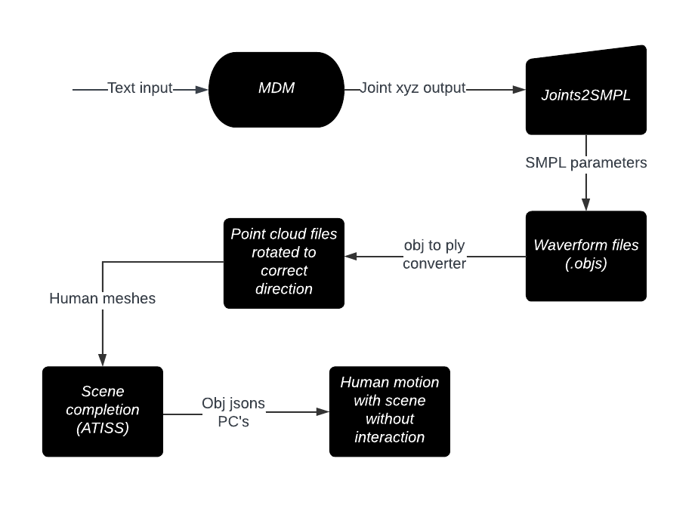
TARGET 3: pipeline
Feed text prompt to MDM to get joint output
Convert output to SMPL form and store OBJS
Convert to point cloud format using python script
Normalize orientation to xy plane by applying a mesh rotation of ( 3𝝿/2, 𝝿, 𝝿)
Apply scene completion algorithm: Simple, fast and gives diverse results with scene.

Slide 28
TARGET 4: Generation of scene with interaction
SMPL and SMPL-X are parametric human body models
Most pure motion synthesis models like MDM give SMPL-mesh based output- with 22 joints.
Most scene completion algorithms like MIME and SUMMON use SMPL-X, as it is a better human parametric model which models hand, face, eye etc.
However, parameters can’t be copied between the two models.
SMPL and SMPL-X shape spaces are not compatible, since each model is the result of a different training process.
Hence it is a useful application to integrate conversion to SMPL-X within a model like MDM, to enable a synthetic pipeline for with scene motion generation
SMPL-X parameters can be used as input to SUMMON
Notes:
Pass output of contactFormer through softmax function using –save_probability argument.
contactFormer now produces a 8 dimensional vector for each vertex of each frame, indicating the probability of each of the 8 object categories.

Slide 29
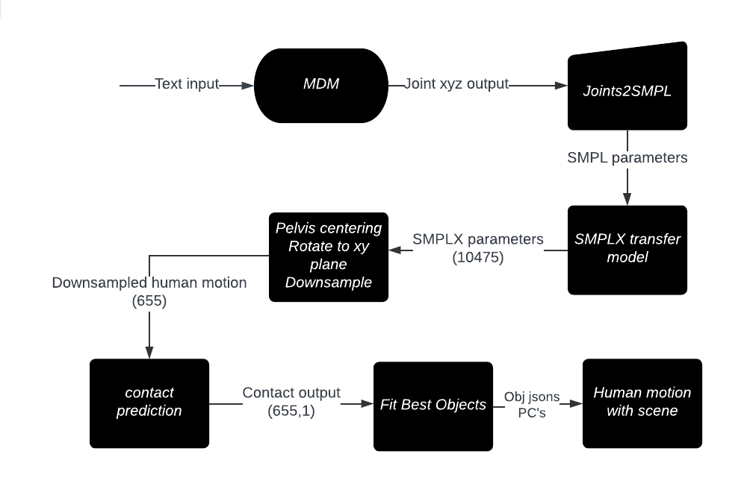
TARGET 4: PROPOSED PIPELINE
Target: HOI scene using human motion from MDM
Convert MDM output of input text prompt to SMPL
Process MDM SMPL output to correct form
Pass the processed SMPL parameters through transfer_model, generating SMPLX parameters
Normalize the orientation of SMPLX mesh and centre the vertices around pelvis. Downsample the mesh
Pass downsampled motion file to SUMMON for scene
Notes:
Pass output of contactFormer through softmax function using –save_probability argument.
contactFormer now produces a 8 dimensional vector for each vertex of each frame, indicating the probability of each of the 8 object categories.

Slide 30
TARGET 4: INTEGRATION PROCESS
Transfer model of SMPLX is used for conversion but has to be modified for taking in MDM input
Difficulties were faced in conversion due to inconsistent naming of different parameters, consistency issues, and many steps across repositories and environments.
Have written script to reduce to only two commands to get final down-sampled and centred around pelvis SMPL-X human motion npz file by adding SMPLX to mdm module.
This integration along with saving time for multiple commands also saves space by not writing unnecessary files like SMPL meshes and SMPL-X meshes before they are needed.
Notes:
(for example root_orient -> global_orient, combination of left and right eye, hands etc into one ‘pose’),

Slide 31
Target 4: DIFFICULTIES FACED
During set up of SUMMON, visualization issue was faced due to lack of “screen” that is needed to visualize Open3D point cloud- fixed by using Xquartz, Microsoft RDP, X11 forwarding
It is noticeable that summon performs well on inference if given human motion from the Proxd dataset
However, it gives poorer results for amass human motion input and for the motion diffusion model input.
Interaction is produced but objects are placed at incorrect positions and are semantically incorrect

Slide 32
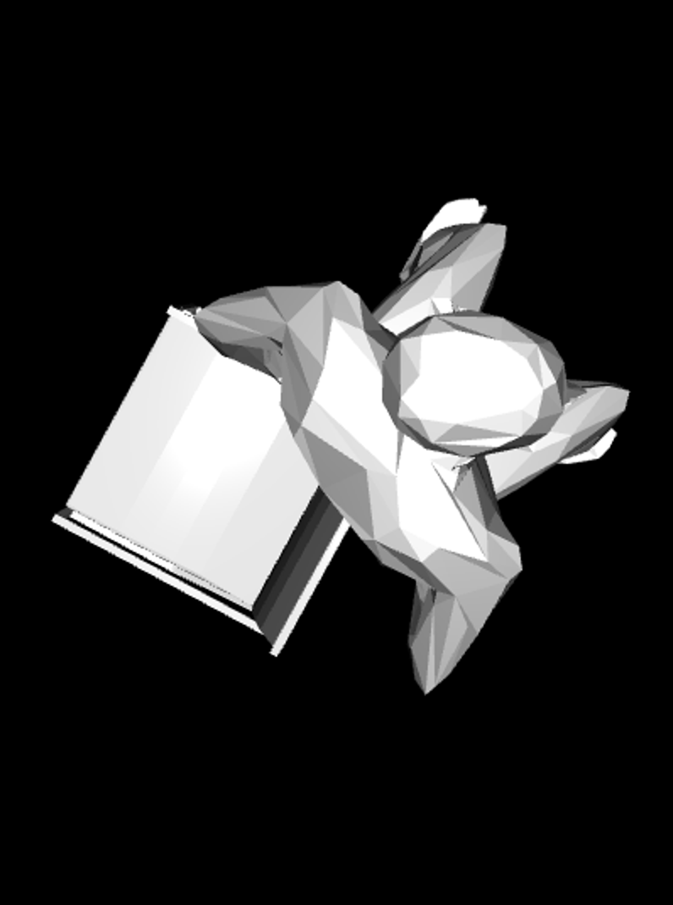
Target 4: DIFFICULTIES FACED
Attempted Process:
Fixing input format: On SMPLX output: Euler matrix transformations, mesh rotations(Rotation of( 3𝝿/2, 𝝿, 𝝿), normalizing orientation to xy plane were all attempted while including down-sampling
Input motion of human sitting had few contact points compared to proxd(near ~70). Attempted improving performance by increasing length of motion (MDM output was enlarged using a python script)
Hyperparameter tuning does not increase performance
Model failure possible due to limited training data: SUMMON model performance needs to be improved.

Slide 33
SUMMARY
Set up MDM and DoubleTake extension that allows generation of variable length T2M, unconditioned, or action based synthesis of human joint positions over time.
Set up SUMMON model for Human motion with scene generation that gives point cloud output of human meshes and objects over time given input SMPLX human motion after preprocessing.
Integrated SMPLX transfer model into MDM and summon environment and wrote script to simplify and accelerate the process of MDM output conversion to SMPLX parameters.
Wrote short script to produce a HumanML3D like densely annotated, large scale, diverse dataset using MDM.
Implemented pipeline to add scene to completely new motions generated using MDM using waveform(.obj) to point cloud(.ply) conversion and ATISS based scene completion algorithm.
Modified code of object fitting in summon to generate diverse scenes with semantically similar objects as well as versions of same objects by manipulating probabilistic output of the contactFormer.

Slide 34
FUTURE WORK
Use of synthetic dataset (first without scene) to generate advanced 6DOF motion prediction algorithm that can be used to reduce latency in AR applications.
Improve performance of synthetic pipeline that takes MDM input to generate HOI
Improvement of performance of SUMMON using augmented training datasets like BEHAVE or COUCH that model HOI interaction, possibly fixing synthetic data pipeline
Environment integration of SUMMON and MDM.
With scene dataset can be used to improve AR algorithms like SLAM

Slide 35
THANK YOU

